Slide 1
IN609
Operations Engineering 1
PowerShell Functions
Lecture 2-1
Semester 2, 2021

Slide 2
Overview
Up to now we talked about most essential concepts
Review
Seeking help
File output and conversion
Piping of objects
Function objects (special objects)
3

Slide 3
‘foreach’ – Iterating over piped input objects
Iterates over input objects and applies operation to individual objects
Example: Show full pathname for all files and
folders in D:
Individual object variable
– dir D: -Recurse | foreach {$_.FullName}
Example:
Property of object
Copying folder C:\source to multiple destinations
"c:\dest1","c:\dest2","c:\dest3" | % {Copy-Item
c:\source -Recurse -Destination $_}
31

Slide 4
Data format conversion
ConvertTo-Html
gps | ConvertTo-Html > "Test.html"
ConvertTo-Xml
ConvertTo-Csv
gps | ConvertTo-Csv | out-file “Test.csv”
Note the use of out-file as an alternative to >
gps | Export-Csv “Test.csv”
ConvertTo-Json
16

Slide 5
Powershell as file processing utility
How could we find out all commands for importing/exporting file content?
Get-command | where
{$_.Name.StartsWith(“Import”)}
Get-command | where
{$_.Name.StartsWith(“Export”)}
Examples
Import-Csv <filename.csv>
Export-Csv <filename.csv>
17

Slide 6
Reading from and writing to files
Reading:
Get-content
Retrieves content of plain (i.e. unstructured) text file
Writing (if not using ‘export-’ cmdlets):
> <filename>
Similar to writing to stdout and stderr in bash
Example
Get-process > processes.txt
Get-Content | test.txt | | | foreach | {Write-
host("Line: | $_")}
18

Slide 7
Functions
Function allows you to encapsulate specific functionality
Why are they useful?
to modularise your code
When using the same functionality repeatedly
– …
4

Slide 8

Functions
Inline specification
function day {“Today is $((get-date).DayOfWeek)”}
Functions with arguments
5

Slide 9
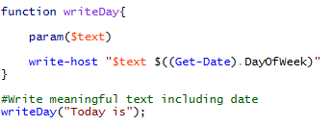

Functions
Functions with in-code parameters
Using special variable $Args for parameters
6

Slide 10
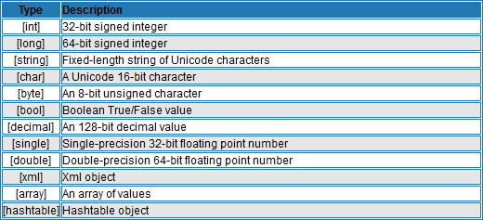
Datatypes in Functions
Source: http://www.powershellpro.comO/ppeorwatienrgsShyestlel-mtuCtoonrcieapl-tsintroduction/powershell-functions-filt7ers/

Slide 11
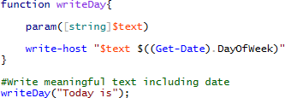
Typing parameters
Best practice: Always specify datatype in scripts
Hardens your script: Will give error message when receiving unexpected datatype
Documentation: Third party knows the expected datatype

Slide 12
Parsing Strings
$x = get-content <filename>
Variable contains the file content as array of lines
Lines can be accessed using index (zero-based)
– Line 6: $x[5]
Only line 2 and 6: $x[1,5]
Range of line 2 to 6: $x[1..5]
One liner for first 5 lines of file: (get-content <filename>)[0..4]
Select-string to match lines against strings (-SimpleMatch) or Regex patterns (-Pattern) along with various options
$x | select-string -SimpleMatch -CaseSensitive “PoWeRShell"
Returns MatchInfo object that has further properties (e.g. actual
content (.Line), line number (.LineNumber))
$x | select-string -SimpleMatch “PoWeRShell“ | get- member
Example returning the line number(s!) for a matching string
$x | select-string -SimpleMatch “PoWeRShell“ |
foreach-object {$_.LineNumber}
$x | select-string -SimpleMatch “PoWeRShell“ | select LineNumber
19

Slide 13
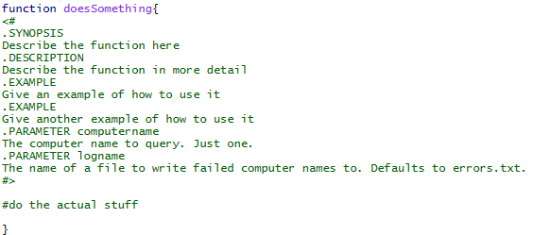
Documentation

Slide 14
Resources
Default Reference for PowerShell:
https://technet.microsoft.com/en- us/library/hh847741.aspx
Specific information about core modules
https://technet.microsoft.com/library/hh849695. aspx
Good blog for specific PowerShell tips
http://blogs.technet.com/b/heyscriptingguy/
21

